Slide 1

Project Proposal: Loan Approval Prediction Using Machine Learning
Team Contributors include Maryann Grace, Tyquese Taplin, Isaiah Rollie, Logan Dameron, Metaferya Fitsum, Inshirah Khatib, Cordette Gillis & Charles Williams

Slide 2
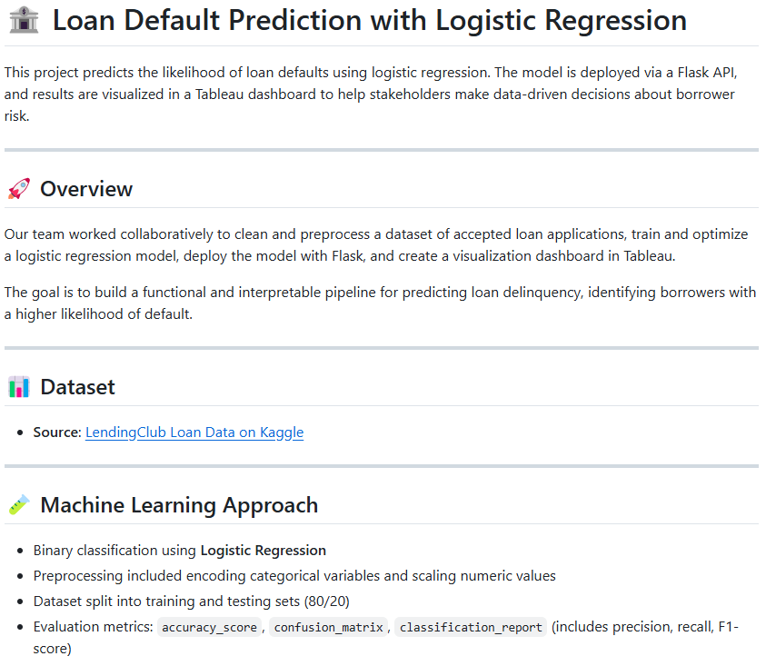

Slide 3

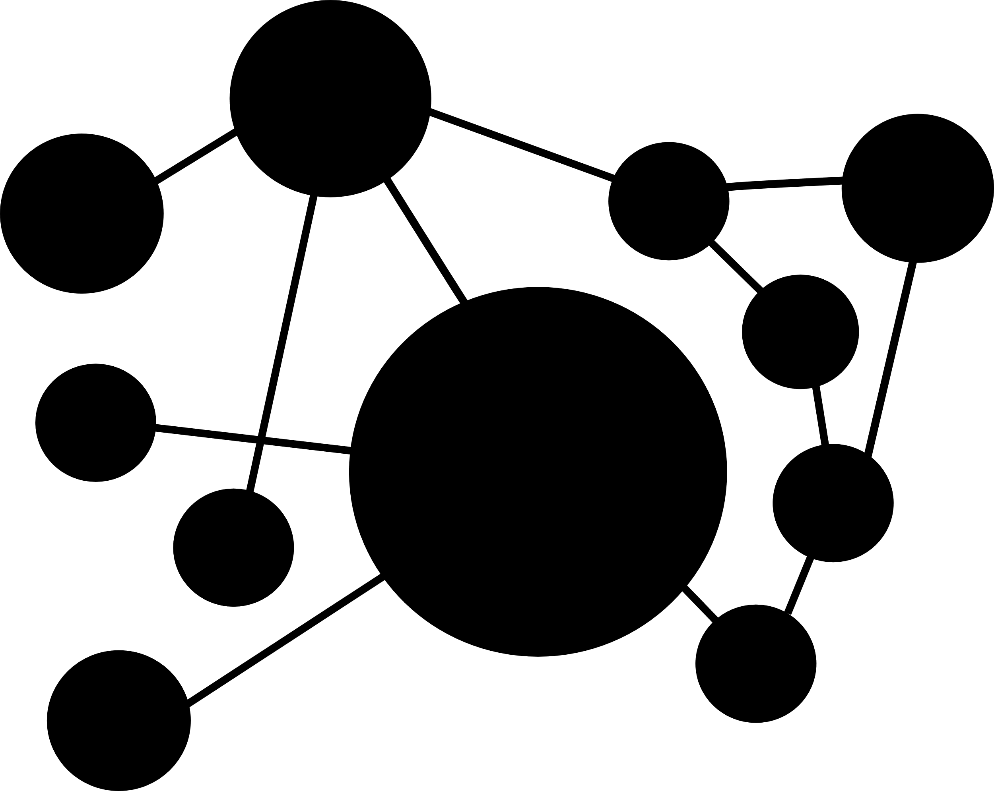

Main Objective
To build a machine learning model that predicts the likelihood of loan defaults using logistic regression based on borrower financial and demographic details. The goal is to simulate a data-driven loan evaluation system that mirrors the decision-making process of real-world lenders. By analyzing features like income, credit history, loan amount, and employment status, the model will help predict default likelihood and highlight key contributing factors.

Slide 4

Data Cleaning
We utilized a dataset from Lending Club Loan Data which contained well over 500,000 rows. This data provided insights on past borrowers, including their loan amount, employment status, dti ratio, and loan status. The various statuses ranged from current and paid off, to late (16-30 days. 31-120 days) and charged off.
This csv was loaded to a pandas dataframe, reviewed for missing values, filtered down to necessary columns, trimmed down to fit the repository, and featured engineering was added to determine delinquency status.
1.6M KB -> 34.5KB
This Photo by Unknown Author is licensed under CC BY-SA

Slide 5
Relevant Columns in the Data Set
Loan amount
Term of mortgage
Interest Rate
Credit Grade/ Sub Grade
Employment Length
Annual Income
Purpose
Verification Status
Loan Status Target

Slide 6
Loan Data Set for Training Model
 | 0 | 1 | 2 | 3 | 4
id | 112575999 | 122347826 | 133439083 | 119216681 | 142845437
issue date | 7/1/2017 | 11/1/2017 | 6/1/2018 | 10/1/2017 | 10/1/2018
loan amt | 35000 | 12100 | 17000 | 12000 | 14000
term | 60 | 36 | 36 | 60 | 36
installment | 851.51 | 467.83 | 533.5 | 327.69 | 426.61
emp length | 9 | 4 | 4 | 10+ | 4
home ownership | rent | mortgage | mortgage | rent | mortgage
annual income | 175000 | 106000 | 65000 | 60000 | 57000
verification status | verified | not verified | source verified | verified | source verified
purpose | other | debt cons | credit card | det cons | debt cons
address state | CA | VA | CA | AZ | CA
dti | 13.51 | 27.47 | 12.78 | 26.6 | 10.74
delinquent 2 yrs | 0 | 0 | 0 | 0 | 0
fico range low | 710 | 670 | 700 | 660 | 685
fico range high | 714 | 674 | 704 | 664 | 689
inq last 6 mths | 0 | 0 | 1 | 2 | 0
delinquent | 1 | 0 | 0 | 0 | 0

Slide 7
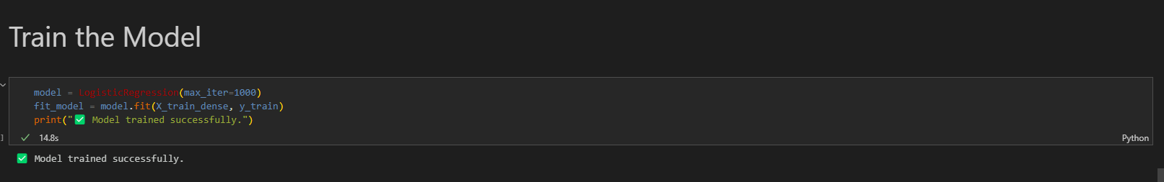
Training the Model

Slide 8
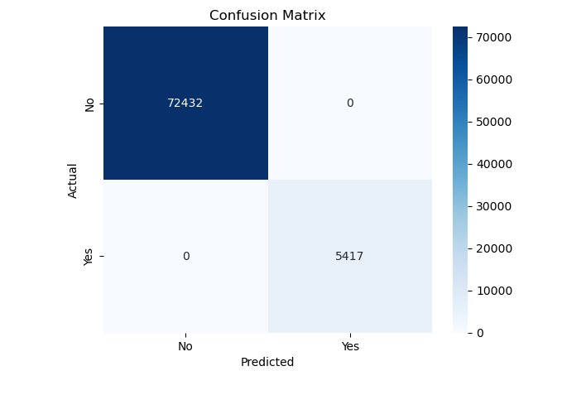
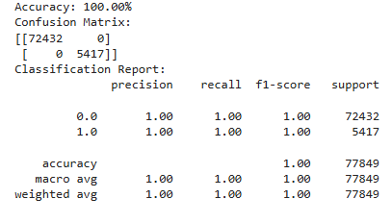
Optimizing the Model
The trained test model created a Classification Report aka “Confusion Matrix” giving us an accuracy: 100.00%

Slide 9
Visualization - Tableau Dashboard
https://public.tableau.com/app/profile/tyquese.taplin/viz/Project4-CreditAnalysis/Story1?publish=yes
Visualizations show approval rates by income, loan purpose, and other features

Slide 10
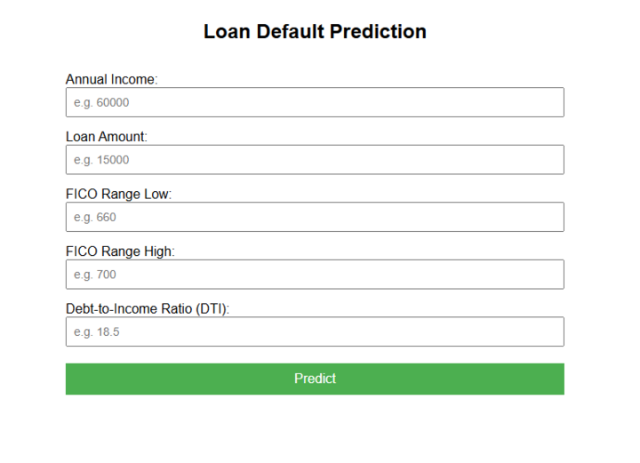
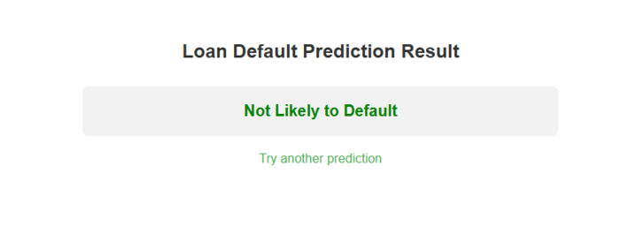
Model deployment

Slide 11
Flask Frontend Development for Loan Default Prediction Overview:
Designed and implemented the frontend for the Loan Default Prediction web application using Flask.
Created user-friendly HTML templates (index.html & result.html) with CSS styling for an intuitive interface.
Key Features:
Input Form (index.html):
Users can input financial details such as annual income, loan amount, FICO scores, and DTI.
Form is structured for clarity with required input fields.
Styled with CSS to enhance user experience.
Result Page (result.html):
Displays loan default prediction dynamically.
Uses conditional rendering to show results in red (likely to default) or green (not likely to default).
Includes a link to return to the form for another prediction.
Technologies Used:
Flask: Backend framework to handle requests and responses.
HTML & CSS: Designed and styled user interface.
Jinja2 Templating: Integrated dynamic content in result.html.

Slide 12
Conclusion
Our team created a model for financial institutions that want to analyze a given borrower's likelihood of default. The target audience consists of borrowers seeking a variety of loans. This project focuses on the accuracy of credit scores, the classification report of the borrower, showcases the confusion matrix, and other facets of the loan screening process. This model will help financial institutions quickly assess a borrower’s likelihood of default on a requested loan.
The model predicts delinquency with 100% accuracy.
Expanding the sample size, or looking at data from other major financial institutions, could increase the overall efficacy of the model.

Slide 13
Dataset
Source: LendingClub Loan Data on Kaggle
We are using the LendingClub Loan Data from Kaggle, which contains detailed information on personal loan applications. The dataset includes over 1 million records and covers borrower attributes like income, employment, credit grade, loan amount, and purpose. It is well-suited for a binary classification task. Dataset Link: https://www.kaggle.com/datasets/wordsforthewise/lending- club

